Slide 1
H₂ fuel cell slides

Slide 2
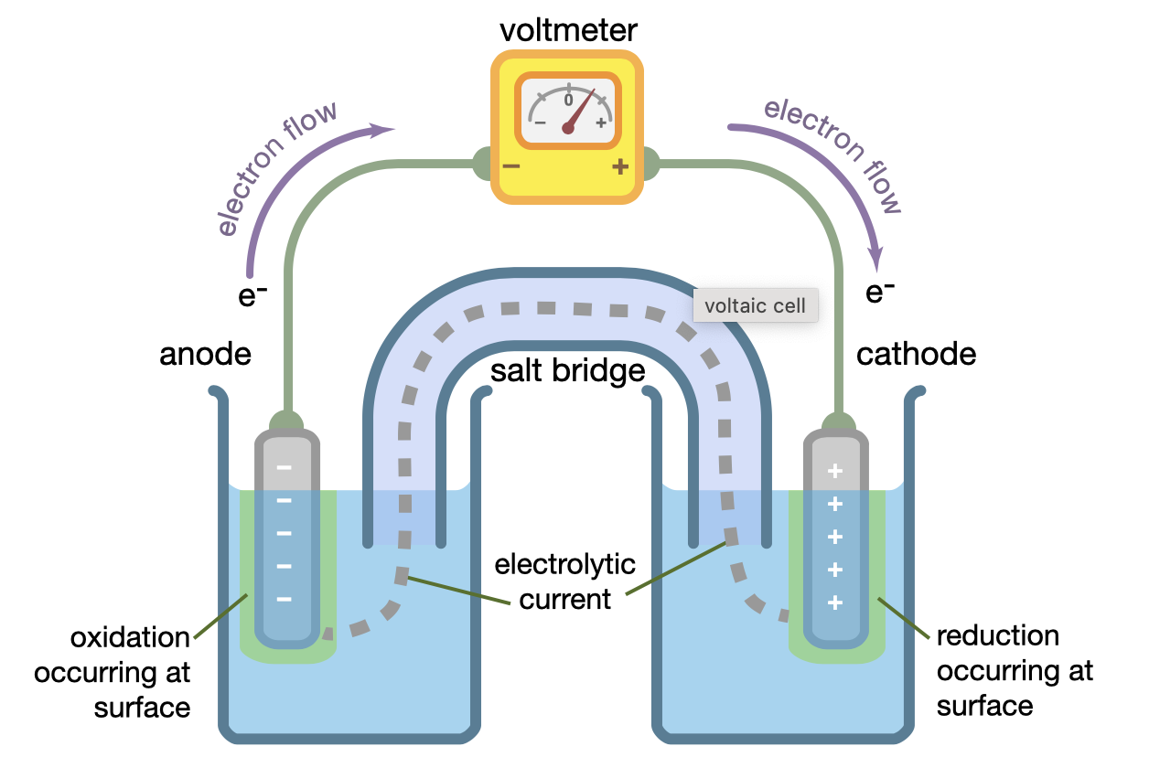
Basic Components of an Electrochemical Cell
Anode- Site of oxidation
Cathode- Site of reduction
Salt Bridge- Pathway for ion transport
Electrochemical Potential:
Energy per change
Varies with position in cell
Cell potential: E_{cathode}- E_{anode}

Slide 3
Hydrogen Fuel Cell Overview
https://www.youtube.com/watch?v=08ZH7vwzzEg

Slide 4
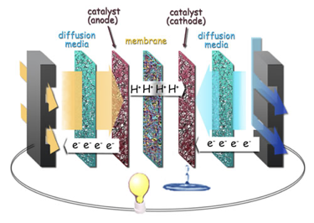
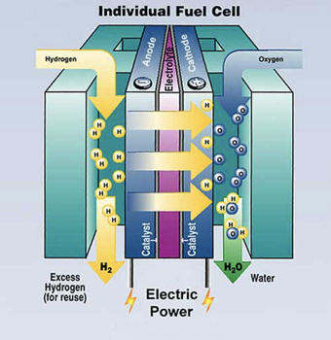
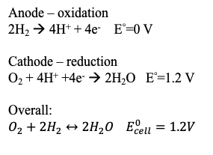
Hydrogen Fuel Cells

Slide 5
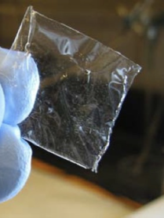
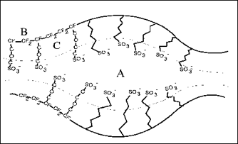
HFC Proton-Exchange Membrane (PEM)
The membrane is a fluoropolymer between the anode and cathode so hydrogen ions can pass through, but not H₂ or O₂
Nafion
Notes:
Slide 8 2017
Maybe use conductivity graph, look into to see if worth talking about
Membrane serves as electrolyte

Slide 6
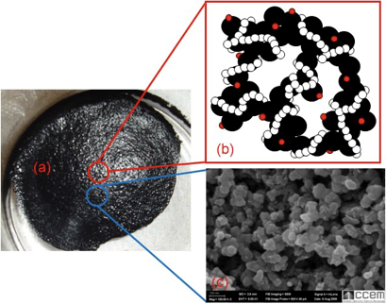
Electrode-Catalyst Design
Platinum electrode-catalyst with nanoparticles dispersed with carbon
Polymer wrapped around to transport hydrogen
Platinum serves as the catalyst
Nanoparticles maximizes surface area and decrease weight

Slide 7
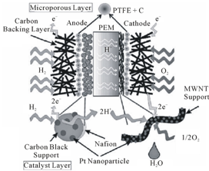
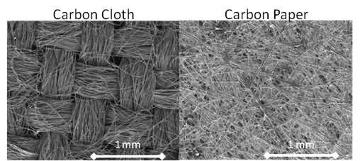
Gas Diffusion Layer
Facilitates transport of reactants and removes the product, water
Fabricated from carbon fiber sheets coated with PTFE (Teflon)

Slide 8
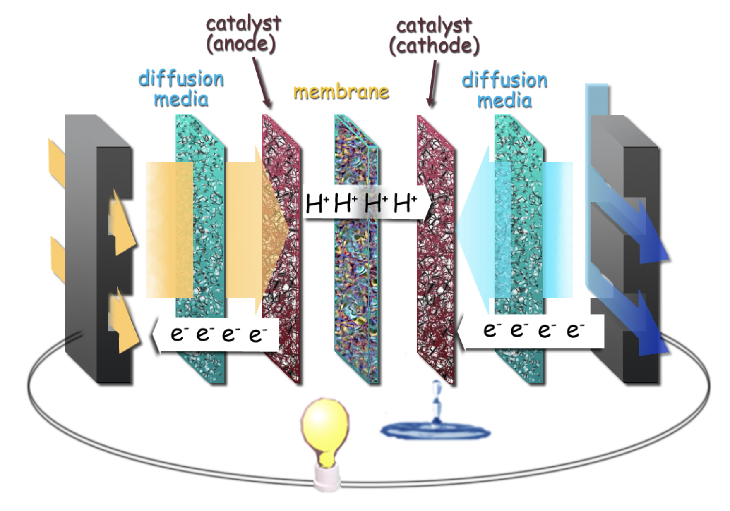

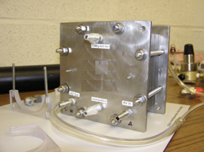
Structure of a Hydrogen Fuel Cell
Grooved plate design allows flow of gas
Size can range from the size of a hand to the size of a laptop

Slide 9
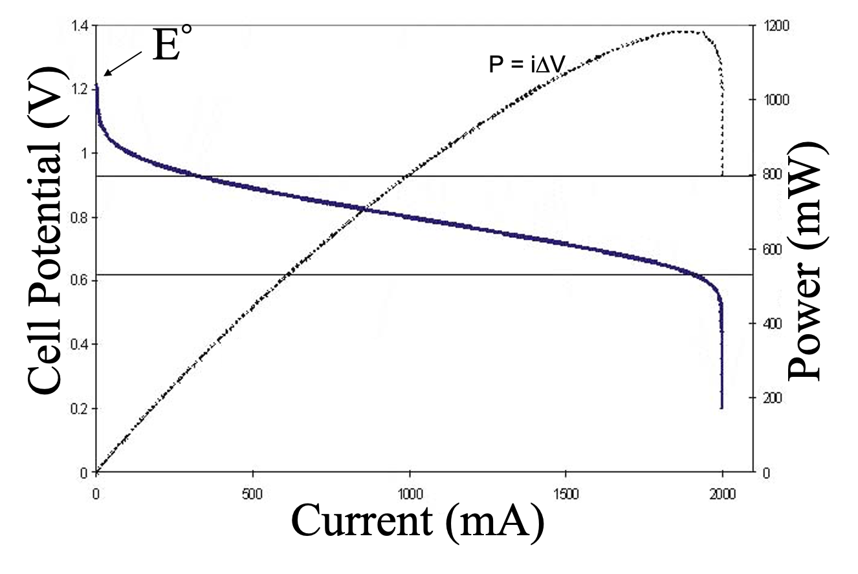
Hydrogen Fuel Cell Polarization curve
Hydrogen Fuel Cell Performance can be separated into 3 regions:
Region 1: Electrode Kinetics Driven Exponential Decay
k=k0 exp⁡[(E0-E)nF/RT]
Region 2: Linear Decay Driven by H+ Transport (Steady State Diffusion)
Region 3: Reactant Limited Decay
Vertical Asymptote due to independence of reactant transport and E
Region 1
Region 2
Region 3

Slide 10
Hydrogen Fuel Cell Polarization curve
At maximum power, the efficiency of the hydrogen fuel cell is 50%
Where Fuel Cell efficiency is given by:
η=∆V/E0
There exists a tradeoff between power and efficiency
How often does one really need maximum power?
Region 1
Region 2
Region 3

Slide 11
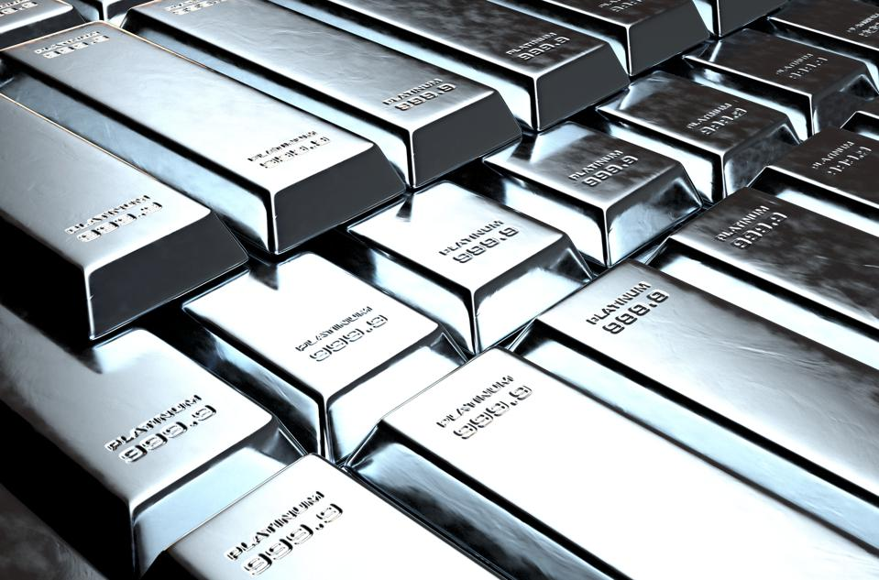
Platinum is the most common catalyst in PEM Fuel Cells
Platinum is used at both the anode and cathode
Small particles exist on the electrode surrounded by larger carbon particles
It currently costs about $38/gram
0.2 grams are required to make a single cell sandwich
The current world reserves are estimated to be 69,000 tons

Slide 12
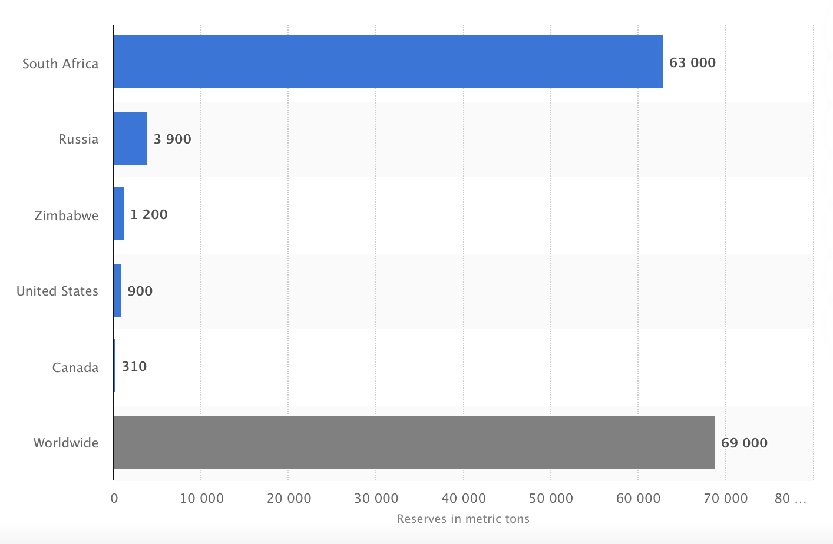
Platinum metal reserves worldwide as of 2020, by country
Most of the world’s platinum exists in South Africa
United States does not have much
We either need to import it, or find a cheaper, more abundant catalyst

Slide 13
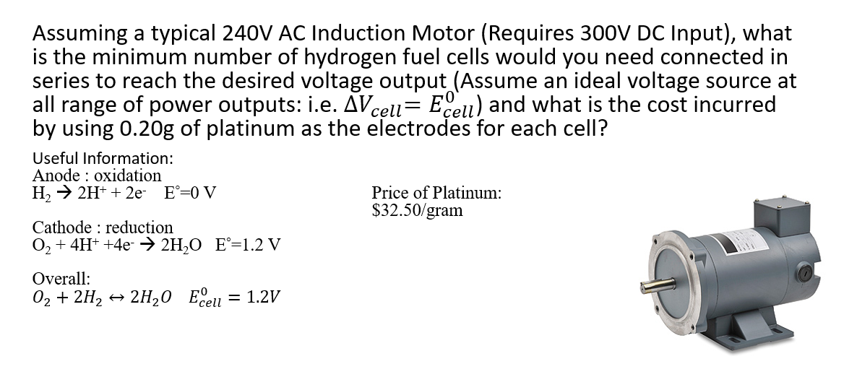
Class Activity #1

Slide 14
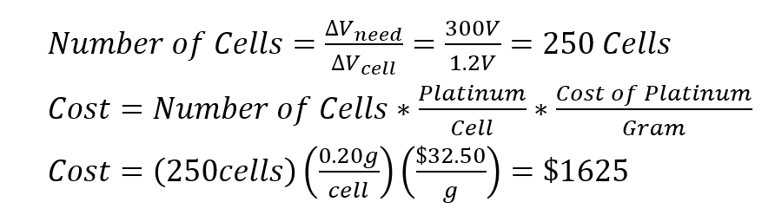
Class Activity #1

Slide 15
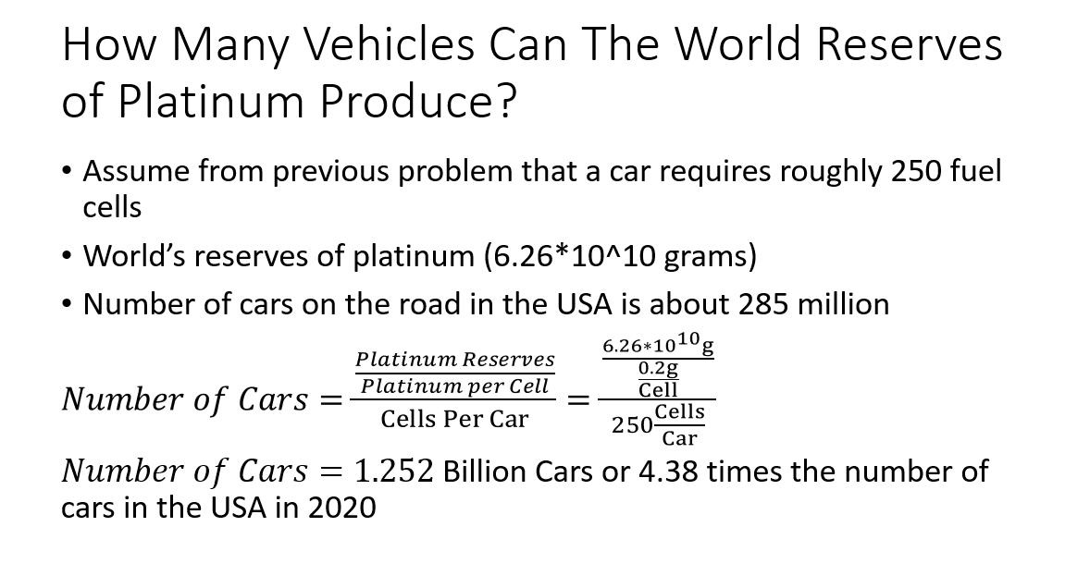

Slide 16
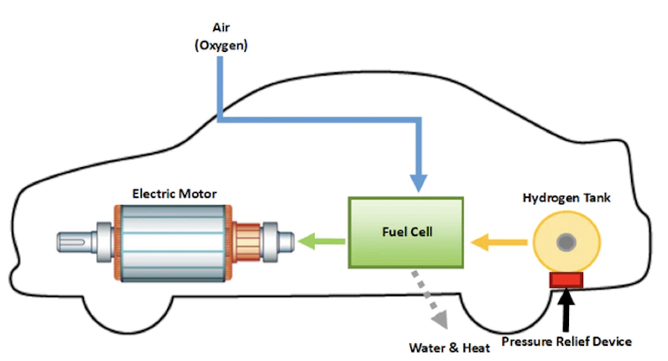
How Hydrogen Fuel Cells are Used in Transportation
Hydrogen and oxygen are supplied to fuel cell stack
Fuel cell produces electricity, heat, and water
Electricity is used to power electric motor
Light-duty fuel cell vehicles can travel for an average of 300 miles before refueling
~3-5 min fueling time
50% theoretical efficiency at maximum power

Slide 17
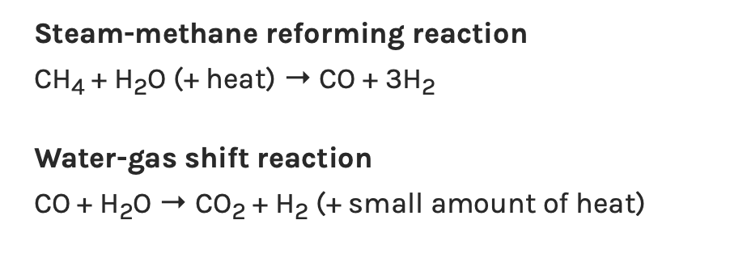
Hydrogen Production- Steam Methane Reforming Process (SMR)
high-temperature steam (700°C–1,000°C) is used to produce hydrogen from a methane source
methane reacts with steam under 3–25 bar pressure in the presence of a catalyst to produce hydrogen, carbon monoxide, and a relatively small amount of carbon dioxide
Subsequently, in what is called the "water-gas shift reaction," the carbon monoxide and steam are reacted using a catalyst to produce carbon dioxide and more hydrogen.
In a final process step called "pressure-swing adsorption," carbon dioxide and other impurities are removed from the gas stream
Currently, the cost to produce Hydrogen via SMR varies between $1.5/kg H2 to $3.5/kg H2
95% of hydrogen fuel is produced via SMR

Slide 18
Pros and Cons of Steam Methane Reforming
Pros:
Cons:

Slide 19
Pros and Cons of Steam Methane Reforming
Pros:
Abundance/Cost of Natural Gas
Existing infrastructure
Can provide enough hydrogen for transportation purposes
Creation of jobs
Cons:
Does produce greenhouse gases
Limited stores of methane
Is it any better than just producing electricity from Methane to charge a Lithium ion battery? Maybe?

Slide 20
Hydrogen Production- Biomass and Coal Gasification
Biomass and coal Gasification and follow a very similar pathway as Natural Gas Reforming Biomass
Biomass Gasification (Simplified example reaction)*
C₆H₁₂O₆ + O₂ + H₂O → CO + CO₂ + H₂ + other species
Water-gas shift reaction
CO + H₂O → CO₂ + H₂ (+ small amount of heat)
Coal gasification reaction (unbalanced): Production of Syngas
CH_{0.8} + O₂ + H₂O → CO + CO₂ + H₂ + other species

Slide 21
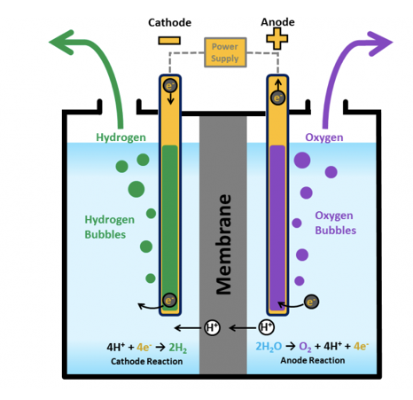
Hydrogen Production- Electrolysis
Electrical current is supplied by electrodes
Water reacts at the anode to form oxygen and positively charged hydrogen ions (protons).
The electrons flow through an external circuit and the hydrogen ions selectively move across the PEM to the cathode.
At the cathode, hydrogen ions combine with electrons from the external circuit to form hydrogen gas.
Anode Reaction: 2H₂O → O₂ + 4H⁺ + 4e⁻
Cathode Reaction: 4H⁺ + 4e⁻ → 2H₂
Currently, the energy value of Hydrogen gas produced is about 80% of the electricity that was used to split the water molecule. Also, the electrolyzers are expensive to manufacture.
Question: Why would we use electrolysis if we lose energy value and it is expensive?

Slide 22
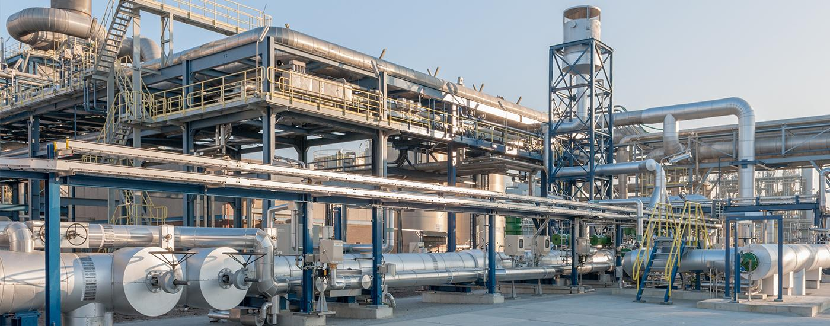
Distribution- Centralized Production of Hydrogen
Large, centralized production facilities where hydrogen is produced via electrolysis, SMR with sequestration, or coal gasification with sequestration
Ideal for long-term

Slide 23
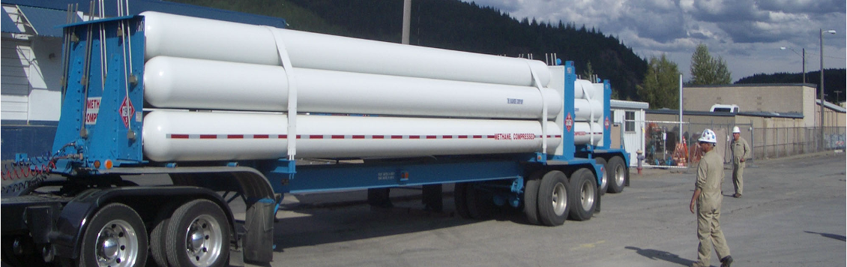
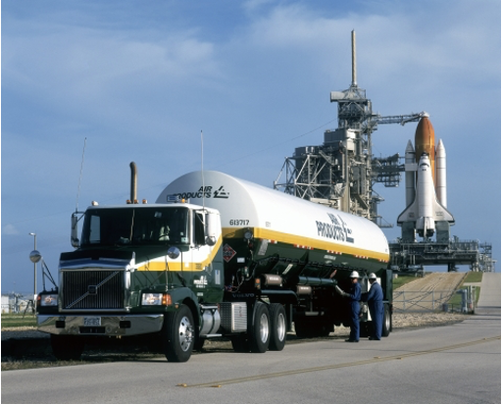
Transportation from large, centralized facilities
Gaseous Hydrogen Transportation:
Hydrogen Tube Trailers (Pressures of up to 250 bar)
Pipelines (Similar to natural gas pipelines; but with a higher tendency for leakages due to the small size of hydrogen)
Liquid Hydrogen Transportation:
Super-insulated tanker trucks certified for cryogenic transport
More dense than gaseous hydrogen (uses 30% of energy density of hydrogen)

Slide 24
Benefits/Drawbacks of Centralized Hydrogen Production
Benefits:
Can be produced cheaply after high capital cost
Supply enough hydrogen for high fuel cell vehicle density
Potential to have zero emissions if produced via electrolysis or if sequestration is used
Drawbacks:
Massive capital cost
Chicken egg dilemma, which came first?
Could be dangerous to transport high pressure vessels

Slide 25
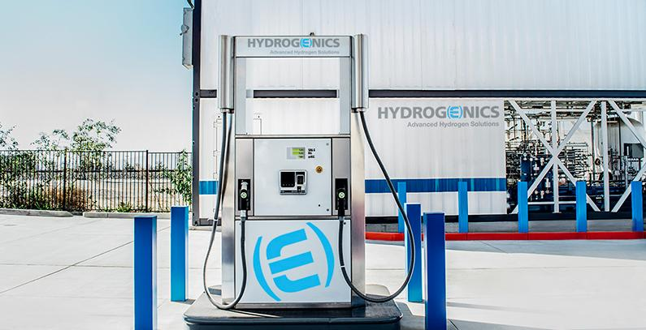
Distributed Manufacture of Hydrogen
local distributed generation with small-scale natural gas reformers or by electrolysis of water
Much lower capital cost
Can be built slowly as demand increases until the need for a centralized production facility arises
Much more likely case for near future

Slide 26
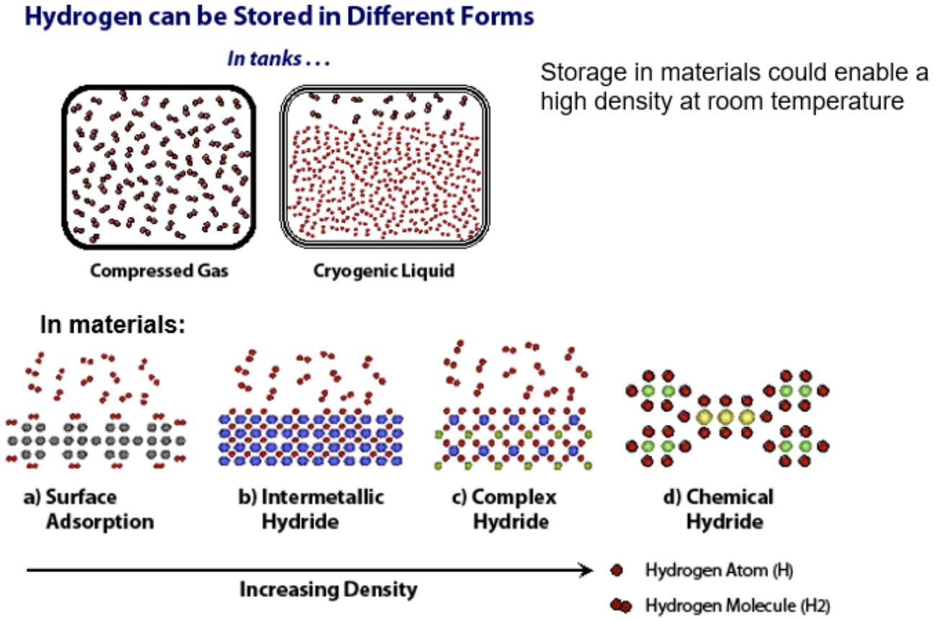
Storage of Hydrogen

Slide 27
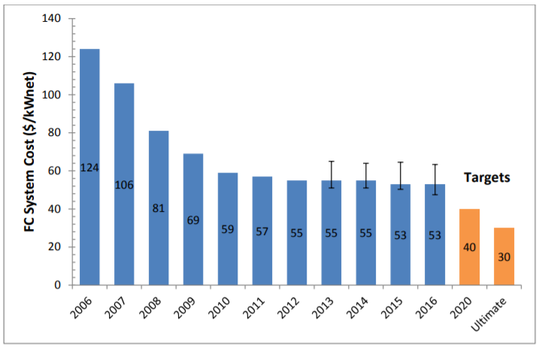
The Need to Create Cheaper Fuel Cells
Advancements already made:
Cost of fuel cells decreased 60% from 2006-2016
5x reduction in platinum content
Advancements that need to be made:
Cheaper alternative to platinum catalyst (~$30,000/kg)
Reduce the cost of hydrogen fuel ($16/kg)
Gasoline Gallon Equivalent (GGE) average price of hydrogen fuel in California: $5-$6
Average price of gasoline in California: $3.88

Slide 28
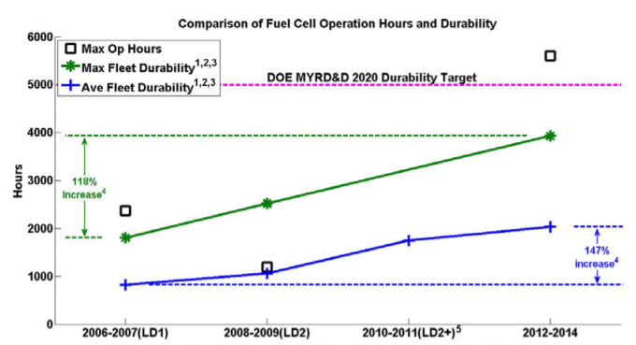
The Need to Create More Durable
Advancements already made:
Quadrupled fuel cell durability from 2006-2016
Achieved durability of 4100 hours (or 120,000 miles)
Advancements that need to be made:
Fuel cells need to be durable enough to last at least 5,000 hours (150,000 miles)
Required for realistic operating conditions that stress chemical and mechanical stability of fuel cell system

Slide 29
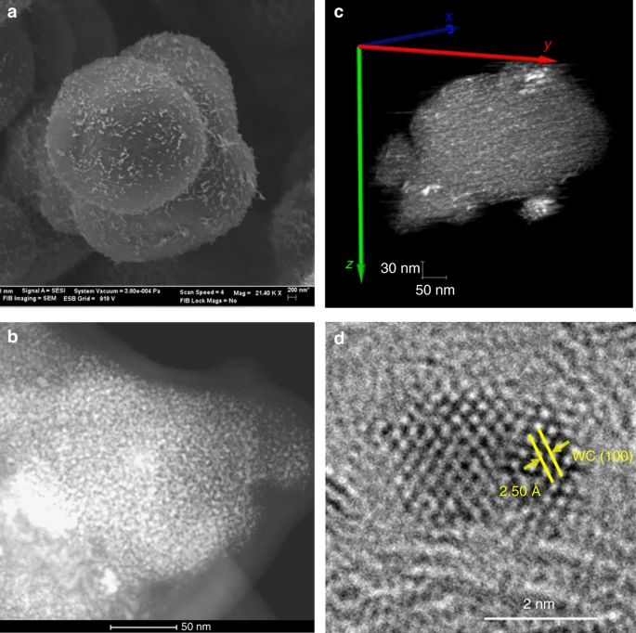
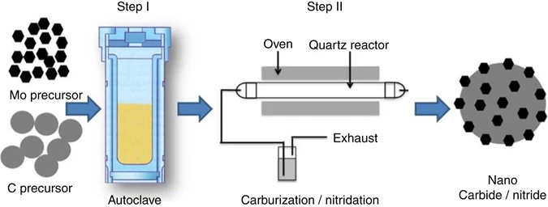
University of Delaware Study - 2017
Cost
Tungsten Carbide Catalyst Cost: $150 per kilogram
Platinum Catalyst Cost: $30,000 per kilogram
Membrane of Hydrogen Fuel Cell can easily wear down but:
Tungsten carbide catalyst found to optimize performance
Tungsten carbide catalyst captures damaging free radicals before they degrade the membrane
Membrane lasts longer when use tungsten carbide catalyst

Slide 30
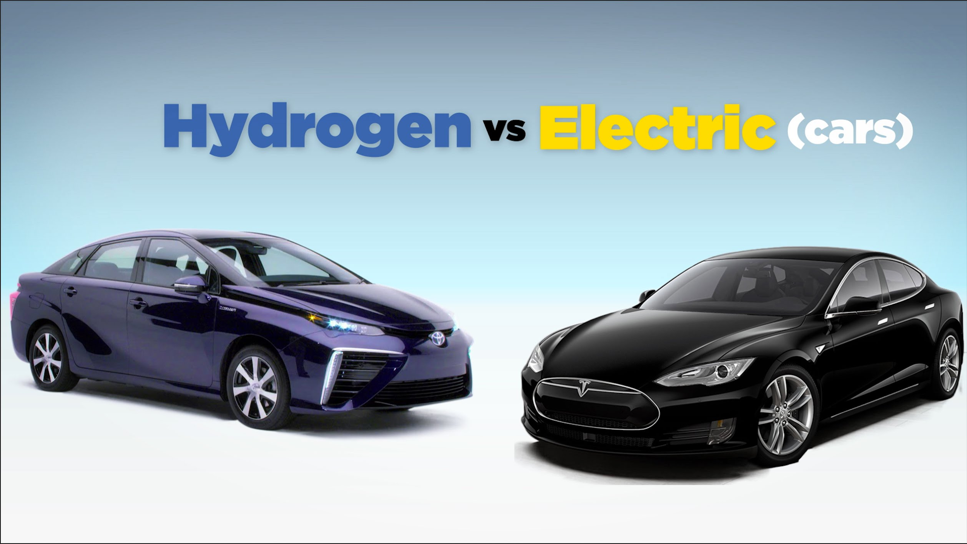

Advantages & Disadvantages compared to Electric Vehicles
Advantages:
Time it takes to Refuel: shorter refueling time (3-4 mins vs. 0.5-12 hrs)
Equipment: Hydrogen Fuel Cells are lighter than batteries used in EVs
Use of Lithium Ion Batteries: only used in EVs & produce a lot of toxic waste
Disadvantages:
Cost: Start at $71.5K (per FCV) vs. $25K (per EV)
Cost per mile: 25¢ per mile (FCV) vs. 3-4¢ per mile (EV)
Convenience of Refueling: more refueling stations for EVs
Cost of building Refueling Stations: cheaper to build EV refueling stations
Hydrogen Extraction: expensive and not very efficient
Environmental Impact: CO₂ emissions from EVs over their lifetime is lower than emissions from FCV
Hydrogen Fueling Stations in California

Slide 31
Advantages & Disadvantages compared to Internal Combustion Vehicles
Advantages:
Noise: FCV produce almost no noise compared to ICV
Environmental Impacts: FCV produce way less harmful gas emissions
Production of Hydrogen vs. Gasoline: Producing hydrogen emits 34-50% less GHG than producing gasoline
Chemical Exposure: when fueling Hydrogen Vehicles, we are exposed to less harmful chemicals
Efficiency: Hydrogen fuel cells are 40-60% efficient in generating electricity & IC engines are 30-35% efficient
HFCV get double the mile range
Disadvantages:
Initial Cost: FCV are 7.5x more expensive
Cost of Fuel: hydrogen fuel is much more expensive than gasoline
Cost of Storage and Transportation: more expensive to store and transport hydrogen than gasoline
Refueling Stations: more readily available for ICV

Slide 32
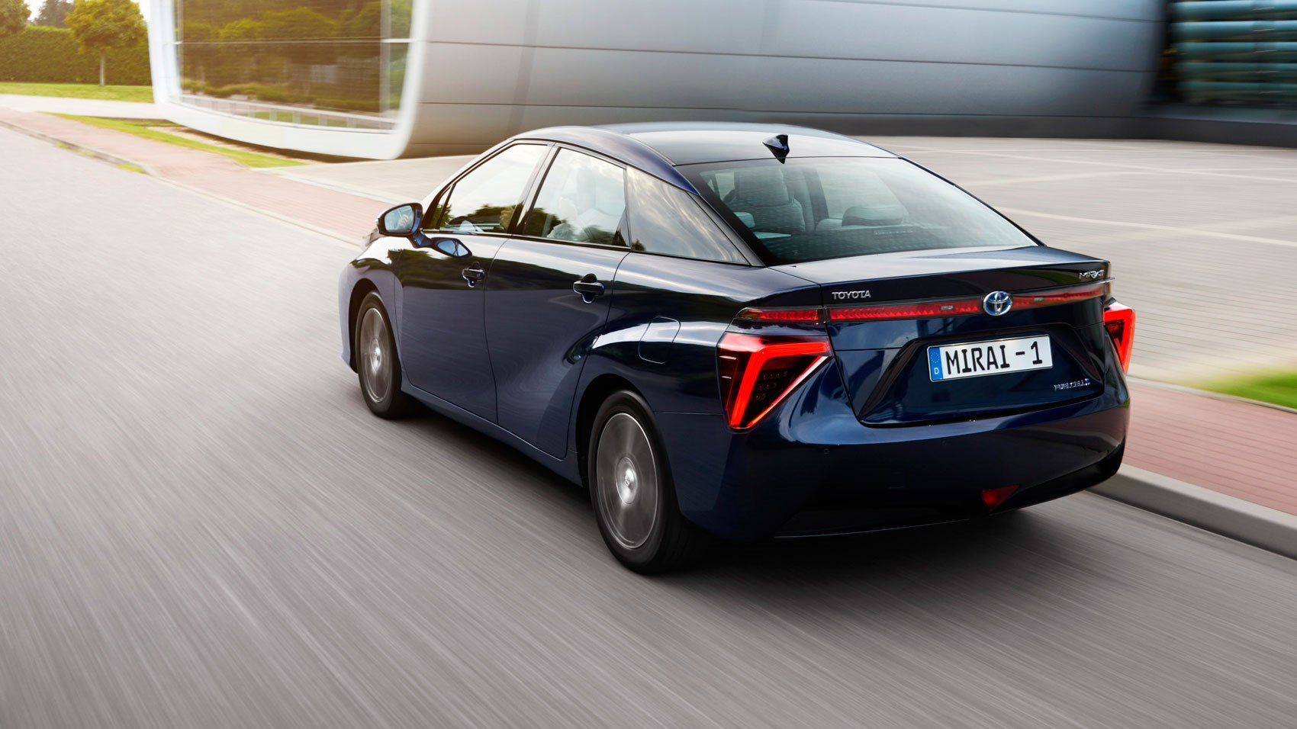
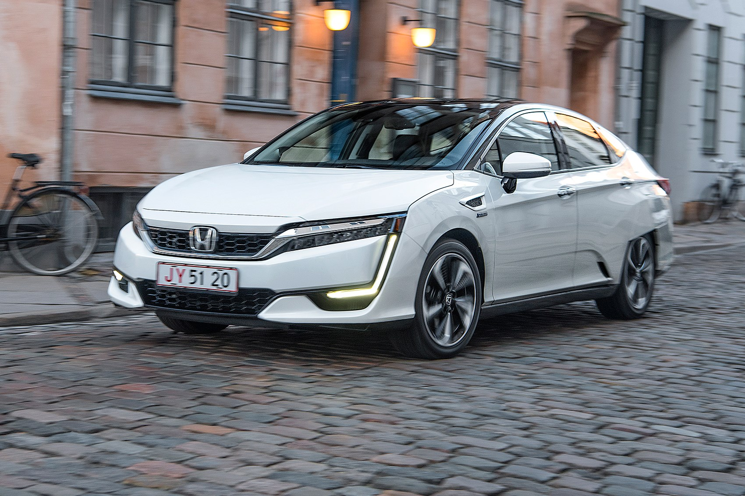

Fuel Cell Vehicles Currently Being Used
2015 Toyota Mirai
Honda Clarity Fuel Cell Vehicle
Since 2012, 8,931 HCV have been sold in the US
Can mainly operate in Cali (43 out of 45 of hydrogen refueling stations are located there)
Progress in HCV
Toyota Mirai (2015) - first to build HCVs in volumes of 1,000+
>6,500 have been leased or sold (2015-2020)
Followed by Honda Clarity and Hyundai Nexo
Only 3 types of HCV currently
Hyundai Nexo

Slide 33

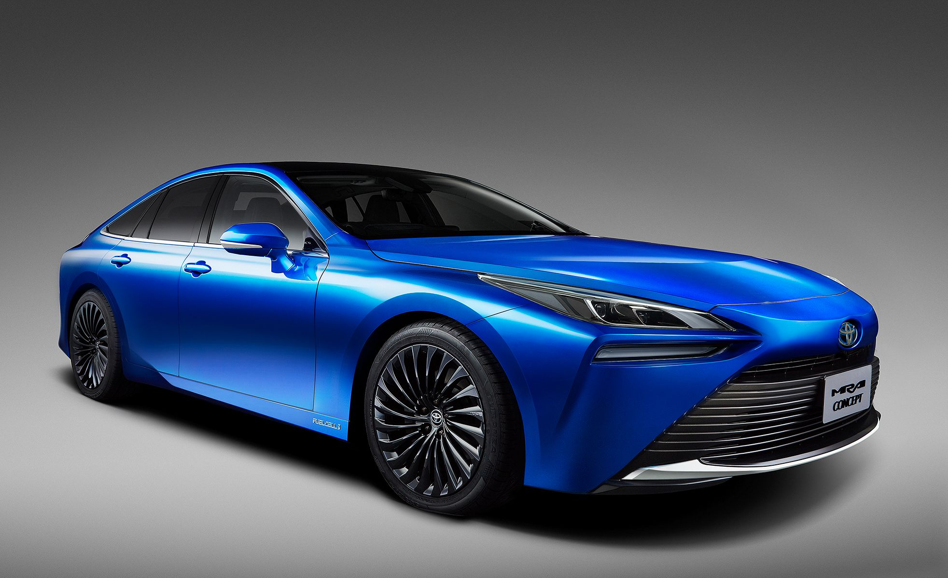

The Future of Hydrogen Fuel Cell Vehicles
Toyota Mirai: 402 mile range
Hyundai Nexo: 380 mile range
Nikola FCEV: 300-900 mile range
Metro/Regional: Nikola Tre BEV (300 mile range)
Regional: Nikola Tre FCEV (500 mile range)
Long-Haul: Nikola Two FCEV (900 mile range)
2021 Hyundai Nexo
2021 Toyota Mirai
Nikola FC Truck

Slide 34
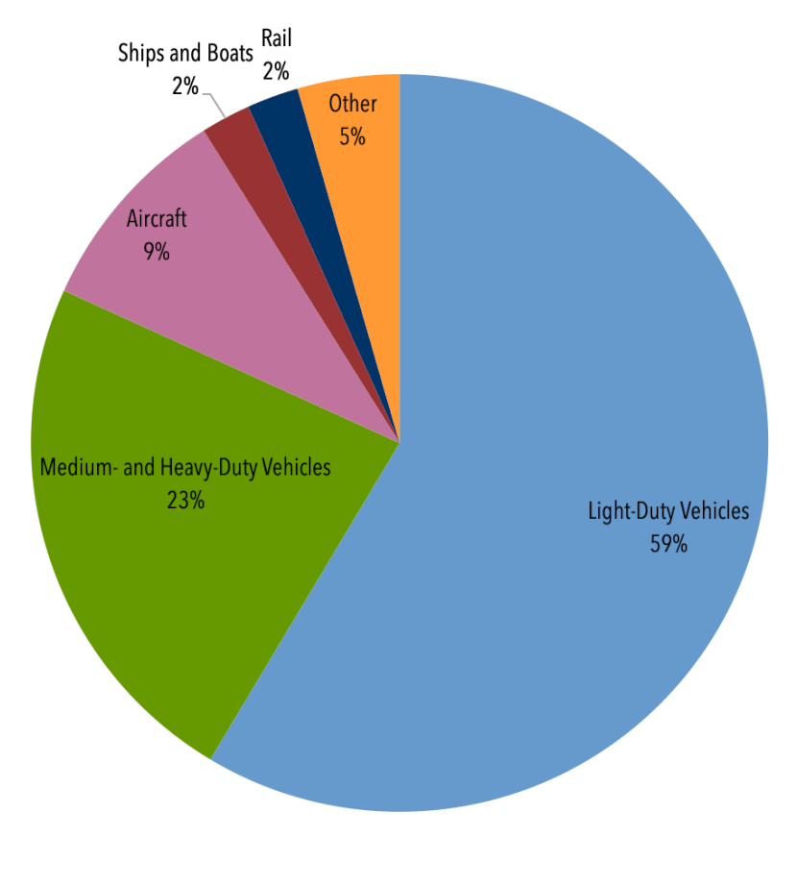
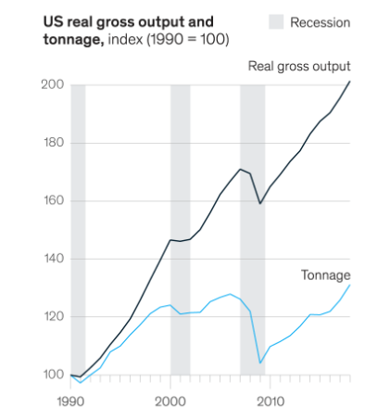
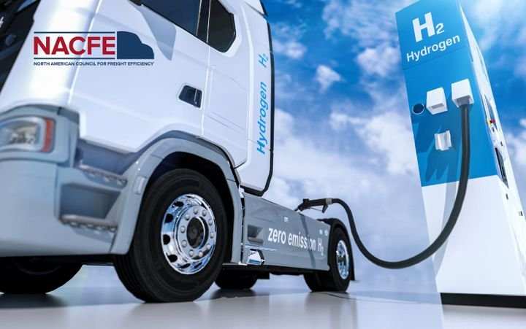
Potential for use in heavy duty vehicles
CO2 Emissions
Why Change Needs to Happen:
US Department of Transportation predicts that freight volume in the US will increase by 45% or 29 billion tons by 2040
Heavy-duty vehicles account for 2% of vehicles on the road, but 23% of CO2 emissions
Truck industry of US, EU, and China combined consumes ⅕ of global demand of oil
Why Hydrogen Fuel Cells vs. Electric
Refueling time
Range
Battery Life Requirements
Higher Specific Energy
Growth of the U.S. Freight Industry

Slide 35
Summary
Polarization Curve displays the trade-off between power and cell efficiency
There is an abundance of Platinum in the world reserves but it is very expensive to obtain
Natural Gas Reforming is where most Hydrogen comes from, but it still emits CO2
Electrolysis could have zero emissions if renewable electricity is used to produce Hydrogen
Centralized production of Hydrogen is ideal for long term, but capital cost is too high for the lack of current demand
Storage of Hydrogen in high pressure gas cylinders seems to be winning
In order to successfully use Hydrogen Fuel Cells for Transportation, we need to find ways to make them cheaper and more durable.
There are currently some Hydrogen Fuel Cell vehicles available for purchase & there are companies working to make new models of HFCV that have a longer range.
It would be most beneficial and profitable to make heavy-duty vehicles out of Hydrogen Fuel Cells.

